Slide 1





W-CERT:
WOMEN-CENTRIC Cyber Emergency Response & Threat-Analysis Framework
Students
Under the Guidance of:
Nishinth Venkatesh | Ayush Dhore
Dr. Vinayak Musale
Neel Karnavat | Sarthak Paymode
BTech. CSE (Cybersecurity & Digital Forensics)

Slide 2








Presentation Agenda
Team Perspective
Implementation
Performance
Literature Survey, Requirements, System Design, and Technical Pillars.
XAI Authenticity, Forensic Cryptography, and Threat Intel Modeling.
Testing Methodology, Experimental Results, and Data Visualization.
Individual Details
Outcomes
Future Scope
Aims, Objectives, and specialized Module Contributions per member.
Publication Details, References, and Accomplishments of the Project.
Blockchain Integration and Real-Time Video Forensic Analytics.

Slide 3


The "Black Box" Problem
Opaque Evidence Analysis
Critical Manual Latency
Traditional forensic platforms treat machine learning as a "black box." Detection outputs lack transparency, making them legally inadmissible because the underlying reasoning is hidden from judicial scrutiny.
Manual triage of cyber incidents introduces dangerous latency. Proliferating deepfakes and synthetic media compromise digital artifacts faster than manual inspection can verify.
W-CERT provides "Glass-Box" transparency through Threat Intelligence & Explainable AI (XAI).

Slide 4

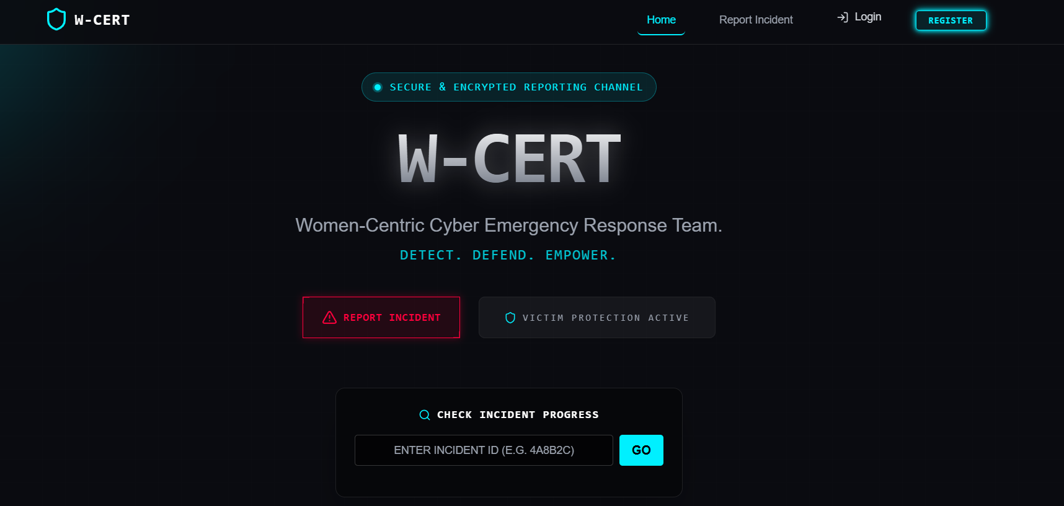
Project Scope & Objectives
Autonomous Verification: Engineering an XAI-powered checker to transform detection into a legally interpretable format.
Evidence Immutability: Establishing a mathematically irrefutable chain of custody through millisecond-level hashing.
Threat Modeling: Automating telemetry correlation with MITRE ATT&CK for rapid jurisdictional escalation.
Cloud-Native Deployment: Designing a decoupled microservices architecture for scalable incident management.

Slide 5
Literature Review Summary
Focus Area | Earlier Approaches | W-CERT Paradigm Shift
Evidence Interpretation | Opaque "Black Box" detection outputs. | "Glass Box" XAI Heatmap Rationales.
Chain of Custody | Manual, human-error prone logging. | Automated SHA-256 Digital Fingerprints.
Threat Triage | Static indicators of compromise (IoCs). | Dynamic MITRE ATT&CK Metadata Mapping.
Deployment | Monolithic, high-latency architectures. | Decoupled Cloud-Native Microservices.

Slide 6

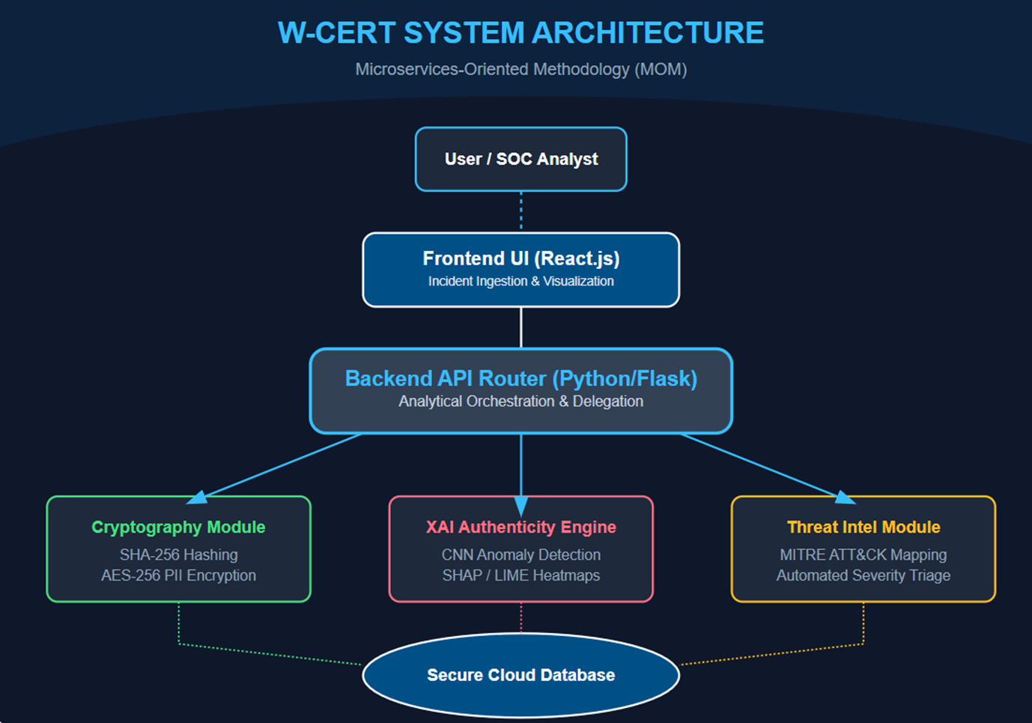
System Architecture (MOA)
Microservices Methodology
W-CERT utilizes a Microservices-Oriented Paradigm partitioned into four specialized modules:
React Dashboard: Secure ingestion interface.
Python Routing Engine: Core API delegation.
XAI Authenticity Checker: CNN-based analysis.
Cryptographic Layer: SHA-256 integrity sealing.

Slide 7
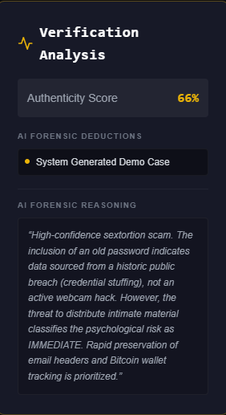
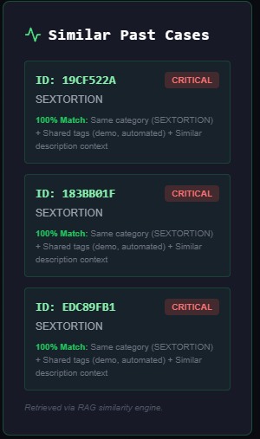

XAI Authenticity Checker
Glass-Box Visual Proofs
Post-inference rationales are deployed using SHAP and LIME algorithms to measure feature importance. The engine generates interpretable visual heatmaps.
This delineates exact coordinates of digital manipulation, ensuring technical evidence is understandable for judicial examiners and non-expert legal users.
Recall Rate: 100% in prioritizing high-severity multimedia threats.

Slide 8
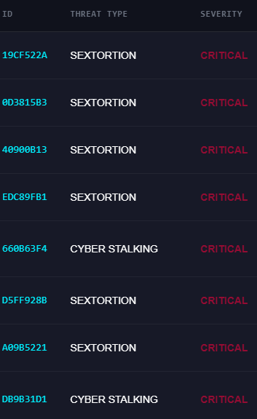
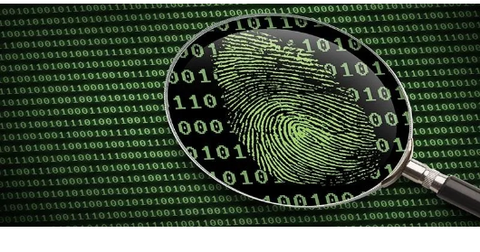
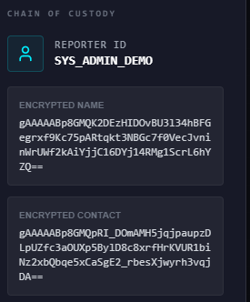

Forensic Cryptography
Secure Chain of Custody
Evidence is processed in binary chunks at the millisecond of upload to generate unique digital fingerprints.
AES-256 (CBC): Encrypting sensitive PII at rest.
Data Integrity: Detects even single-pixel alterations.

Slide 9
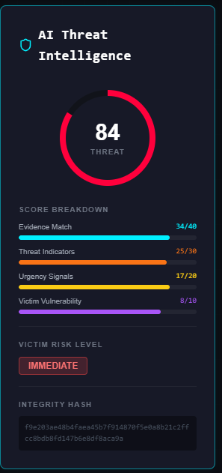
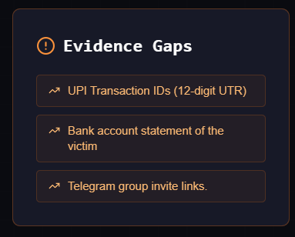
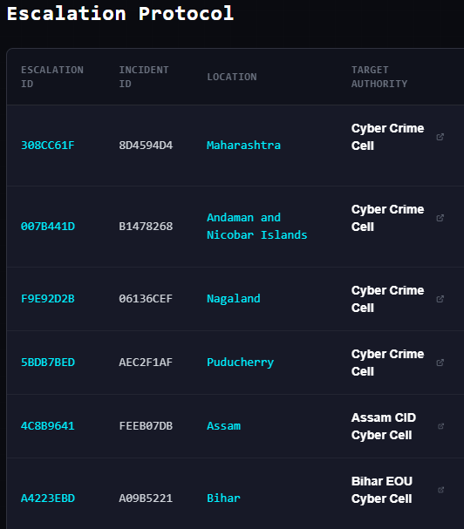
Heuristic Threat Intelligence
91%
Detection Accuracy
MITRE ATT&CK Correlation
The backend correlates incident metadata against standardized global frameworks to automate triage.
check_circle NLP Parsing: Scanning descriptions for TTP keywords.
check_circle Severity Routing: Automated prioritization of life-threatening vectors like sextortion.
check_circle Zero-Latency Lookup: O(1) dictionary-based indicator matching.

Slide 10
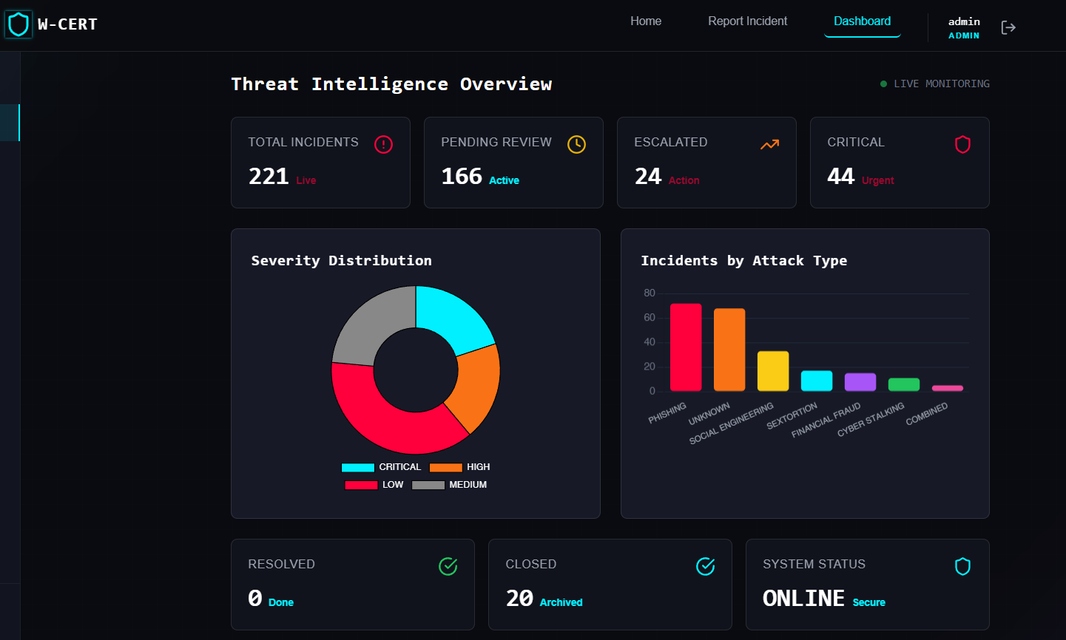
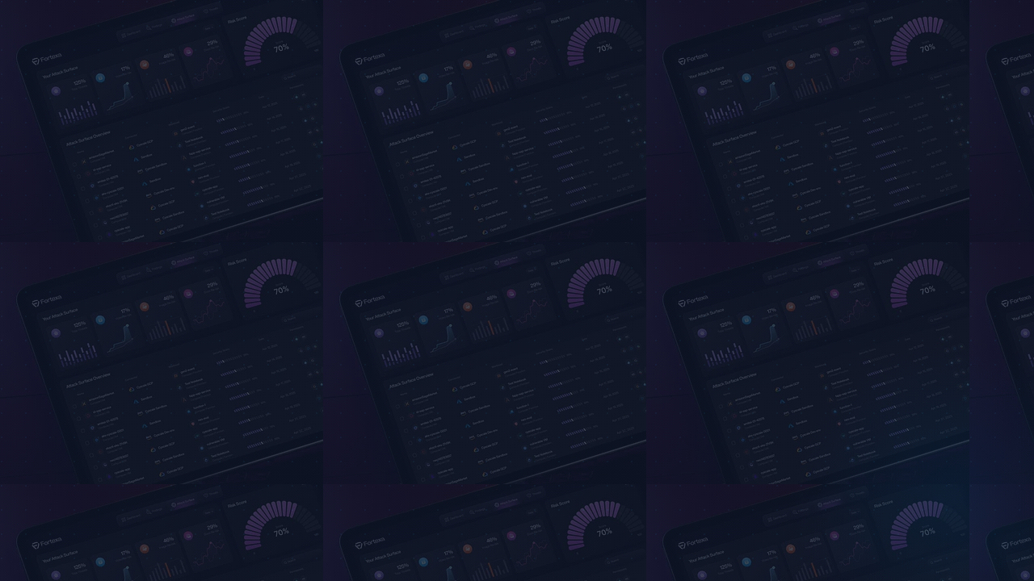
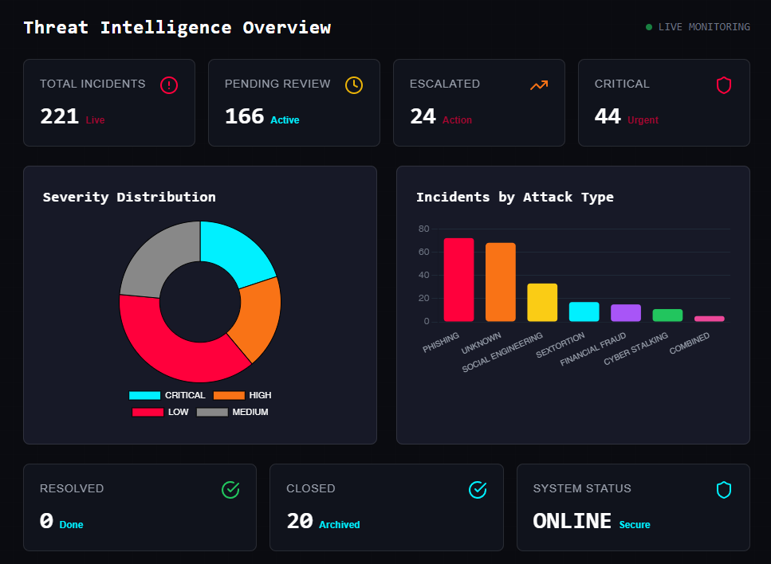
Frontend Orchestration
The Analyst Dashboard, built on React, facilitates high-performance visualization of massive threat datasets and XAI heatmaps with zero operational latency.

Slide 11
Performance Evaluation
Stress testing against production-proximate incident telemetry datasets.

Slide 12

Attack Vector Distribution
Phishing (32.6%)
Social Engineering (14.9%)
Sextortion (7.7%)
Financial Fraud (6.8%)
Cyber Stalking (5.0%)
Unknown / Benign (33%)
Experimental Sample: 221 telemetry points programmatically ingested.

Slide 13
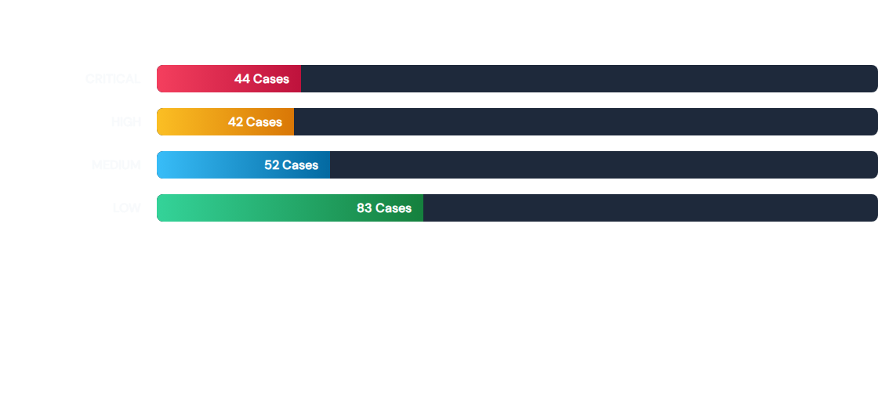
Severity Triage Distribution
Recall Rate: 100% in escalating high-severity, life-threatening vectors.

Slide 14

Individual Details
Nishinth Venkatesh
Architected core Python/Flask routing engine.
Aim: To engineer REST API routing, manage cloud deployments, and automate threat triage.
Developed weighted multi-category threat scoring algorithm.
Objective: Deploy a heuristic engine for parsing telemetry to established cyber threat vectors.
Enforced secure environment configuration (.env).
Coordinated overall project documentation.

Slide 15
Individual Details
Ayush Hemant Dhore
Engineered Cryptographic utility scripts for hashing.
Aim: To secure digital evidence and establish an encrypted connection to the database.
Objective: Implement SHA-256 hashing and AES-256 protocols for forensic repositories.
Implemented AES-256 CBC encryption for PII.
Managed Google Sheets API write orchestration.
Enforced millisecond-level chain of custody.

Slide 16

Individual Details
Neel Harshad Karnavat
Built ResNet-based CNN for forgery detection.
Aim: To train detection models and implement XAI to provide interpretable visual proofs.
Integrated SHAP/LIME explanation frameworks.
Objective: Transform black-box AI outputs into transparent, "glass-box" forensic formats.
Developed automated heatmap generation logic.
Managed forensic model metrics and validation.

Slide 17
Individual Details
Sarthak Anil Paymode
Developed React.js component-based console.
Aim: To engineer a responsive GUI optimized for high-stress incident reporting.
Managed multipart/form-data buffering logic.
Objective: Implement dynamic state management for real-time forensic telemetry rendering.
Integrated Axios for secure HTTP orchestration.
Designed real-time XAI heatmap overlays.

Slide 18
Publications & Future Prospects
Publications
Future Prospects
Securing Electronic Patient Health Information (ePHI): An Analysis of Data Security and Compliance with Privacy Regulations
Blockchain-based Decentralized Chain of Custody (Hyperledger).
Real-time Live Video Face-Swap Forensics.
Implementation: Prepared for submission
Automated Dark-Web PII Monitoring microservices.

Slide 19
References
[1] Z. Khalid et al., "Towards a unified XAI-based framework for digital forensic investigations," Forensic Science International: Digital Investigation, 2024.
[2] N. Bharati et al., "Explainable deepfake detection: A multi-model framework... for legal investigation purposes," Machine Learning with Applications, vol. 23, 2025.
[3] F. Khalid et al., "DFP-Net: An explainable and trustworthy framework for detecting deepfakes using interpretable prototypes," in IEEE IJCB, 2023.
[4] S. Tariq et al., "From Prediction to Explanation: Multimodal, Explainable, and Interactive Deepfake detection Framework," ACM Multimedia, 2025.
[5] L. Xia et al., "From Black Boxes to Glass Boxes: Explainable AI for Trustworthy Deepfake Forensics," MDPI / Journal of Imaging, 2024.
[6] "Opportunities and Challenges of Artificial Intelligence in Digital Forensics," IJSECS, 2025.
[7] "A Multi-Protocol, Explainable AI-Based Framework for Real-Time IoT Forensics," in I5CPS, 2026.
[8] M. H. Maruf, "Developing an Explainable AI System for Digital Forensics," ResearchGate, 2025.
[9] S. H. Silva et al., "Deepfake forensics analysis: An explainable hierarchical ensemble of weakly supervised models," FSI: Synergy, 2022.
[10] B. Saha & A. K. Khan, "Investigation of AI-based Deepfake Evidence: A Digital Forensics Approach," ResearchGate, 2026.
[11] T. O'Brien, "MITRE ATT&CK Labeling of Cyber Threat Intelligence via LLM," SANS Institute, 2025.
[12] "MITRE ATT&CK Applications in Cybersecurity and The Way Forward," arXiv, 2025.
[13] "MITRE ATT&CK: State of the Art and Way Forward," ResearchGate, 2024.
[14] C. Ekisa & D. Ó Briain, "Leveraging the MITRE ATT&CK Framework for Threat Identification... in ICS Simulations," IEEE, 2024.
[15] G. P. Singh et al., "NLP-based Cyber Threat Data Analysis with MITRE ATT&CK Techniques," ResearchGate, 2023.
[16] B. Al-Sada et al., "Analysis and Characterization of Cyber Threats Leveraging the MITRE ATT&CK Database," IEEE Access, 2023.
[17] "Cybersecurity Threat Intelligence Automated via Machine Learning: A System for Analyzing Data in Real-Time," IEEE, 2025.
[18] "Applying AI and Machine Learning to Enhance Automated Cybersecurity and Network Threat Identification," ResearchGate, 2024.
[19] I. A. Haji et al., "Blockchain based chain of custody and digital evidence legality in post conflict prosecutions," Frontiers in Blockchain, 2026.
[20] M. T. P. Mukti et al., "Blockchain-Based Chain of Custody in Digital Forensics," Forensics & Security Journal, 2025.
[21] D. Batista et al., "Exploring Blockchain Technology for Chain of Custody Control in Physical Evidence," J. Risk Financial Mgmt, 2023.
[22] S. Nath et al., "Digital Evidence Chain of Custody: Navigating New Realities of Digital Forensics," in IEEE TPS-ISA, 2024.
[23] "Blockchain-Based Chain of Custody Evidence Management System for Digital Forensic Investigations," IEEE, 2024.
[24] K. M. M. Salih & N. Ibrahim, "CustodyChainGuardian: Blockchain of Custody Digital Evidence Preservation System," IEEE, 2023.
[25] "Management of the Chain of Custody of Digital Evidence Using Blockchain and Self-Sovereign Identities," IEEE Access, 2025.

Slide 20


THANK YOU
Questions & Discussion | MIT-WPU Capstone 2025-26
Nishinth V. | Ayush D. | Neel K. | Sarthak P.

